Slide 1
Islamic Empires of Asia 1450-1750
Ottoman
Safavid
Mughal

Slide 2
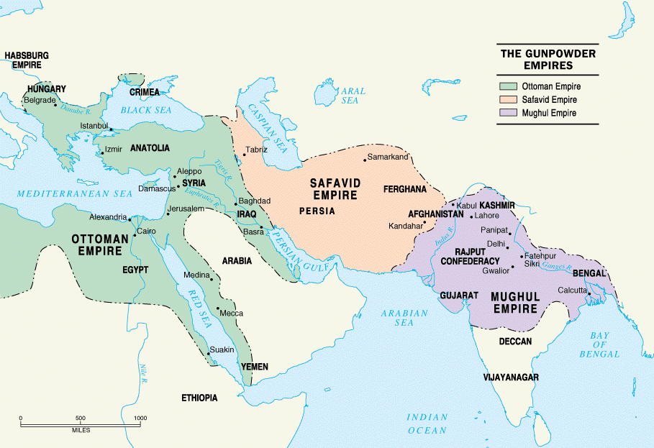
16th Century

Slide 3
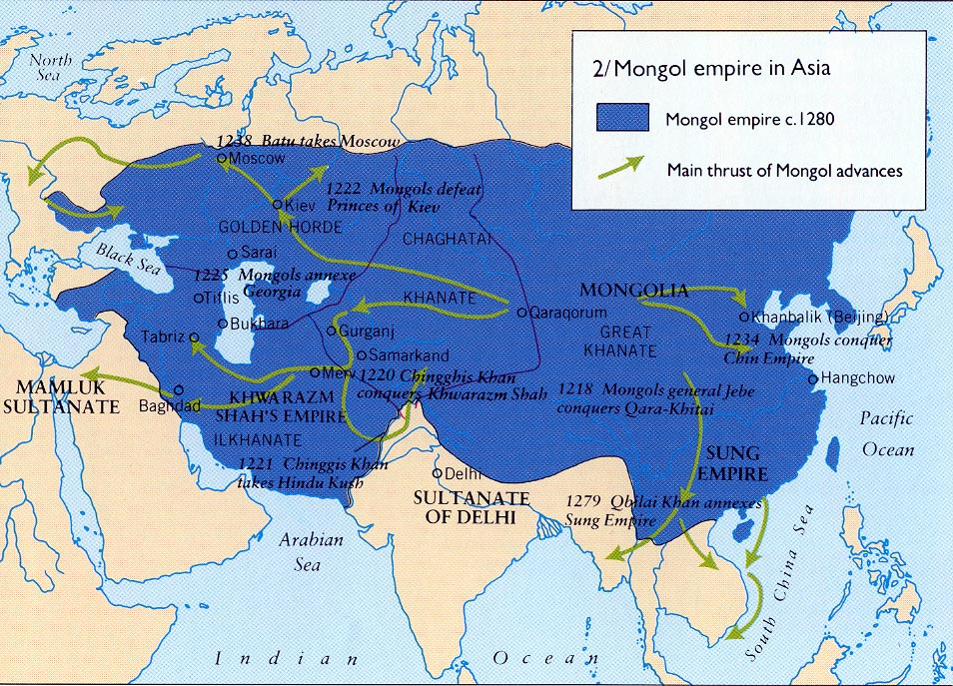
Origins
The change in Mongol cultural patterns that did occur inevitably exacerbated natural divisions in the empire. As different areas adopted different foreign religions, Mongol cohesiveness dissolved. The nomadic Mongols had been able to conquer the Eurasian land mass through a combination of organizational ability, military skill, and fierce warlike prowess, but they fell prey to alien cultures, to the disparity between their way of life and the needs of empire, and to the size of their domain, which proved too large to hold together. The Mongols declined when their sheer momentum could no longer sustain them. US Library of Congress

Slide 4
How did the reasons for both the rise and the eventual collapse of the Mongol Empires direct in many ways the historical development of the Middle East and India in the Age of Gunpowder Empires?
Consider….
Military Prowess
Organizational Abilities
Ethnic & Religious Identity
Momentum?

Slide 5
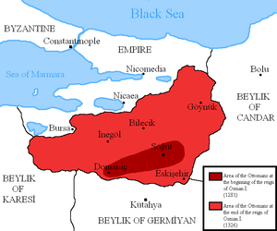
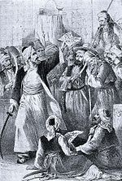
Ottoman Origins…
Chaos of Timur, Seljuk and Byzantine collapse
Osman Bey
Military Prowess
Osman rallying Ghazi “warriors of the faith”

Slide 6
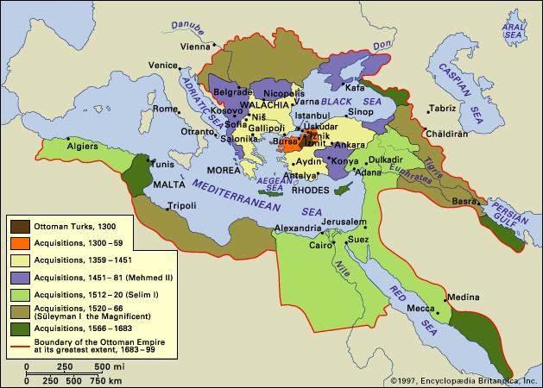
Ottoman Empire

Slide 7
Documents 1 and 2
What do we know about the origins of Safavid and Mughal rule?
How is this similar to Ottoman beginnings?
Began as…“small warrior principalities “

Slide 8
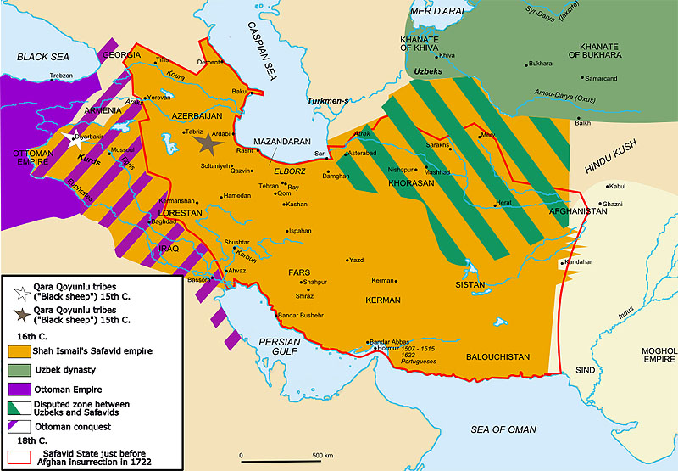
Safavid
Sufi, Shi’ite Origins
Shah Ismail I - founder

Slide 9
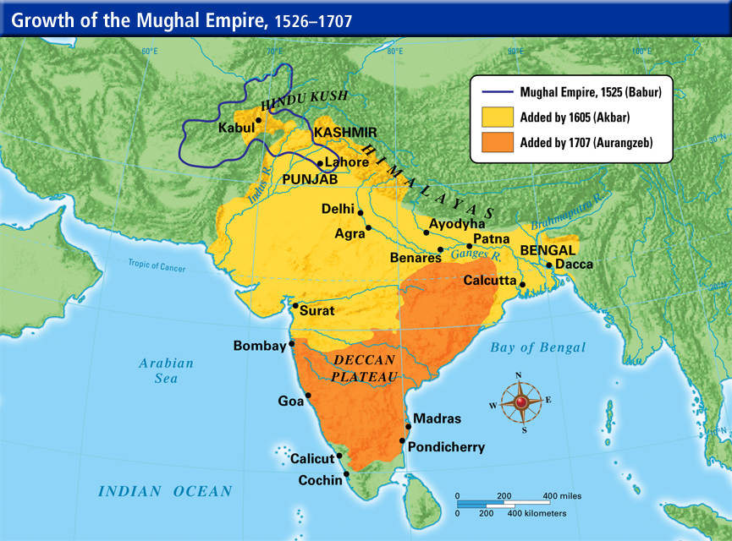
Mughal Empire

Slide 10
Similar in their creation of elaborate …
Administrative Institutions
Authority of autocratic dynasty
Succession unclear
Personal piety and loyalty important
Bureaucracy in service to the Sultan
Military Institutions
Tribal warrior steppe traditions
New ‘gunpowder’ weapons, artillery: Muskets, cannons
Elite Military Corps
Devotion to Islam

Slide 11
Ottoman Empire
1299?-1922
WOW!

Slide 12
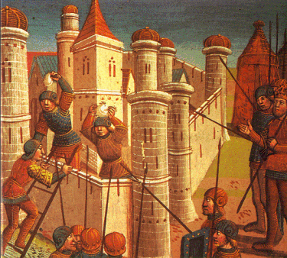
Ottoman: Religion & Politics
Document 3
Sultan Mehmed II “The Conqueror”
Expansion – Two Lands and Two Seas
Black Sea & Mediterranean
Eastern Europe & Asia
Naval Supremacy
1453 “Islam abounds”
Trade, craftwork continues
Suleyman the Magnificent
The Lawgiver
r. 1520-1566
Apogee of Ottoman Power

Slide 13
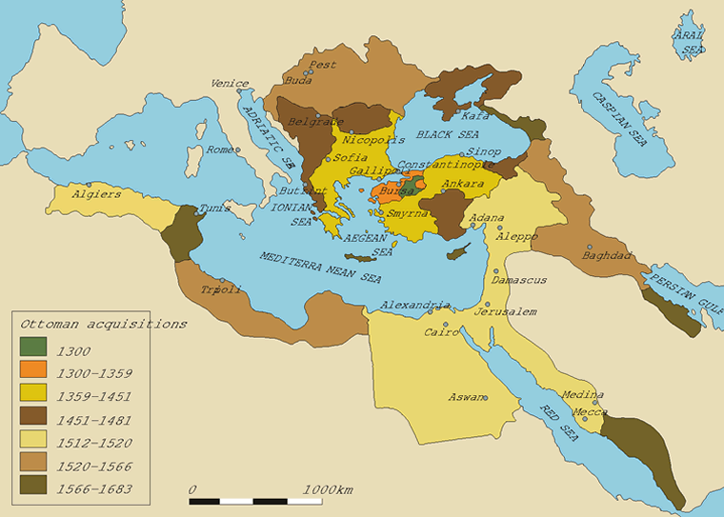

Slide 14
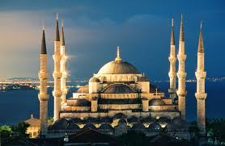
Hagia Sophia… Mosque

Slide 15
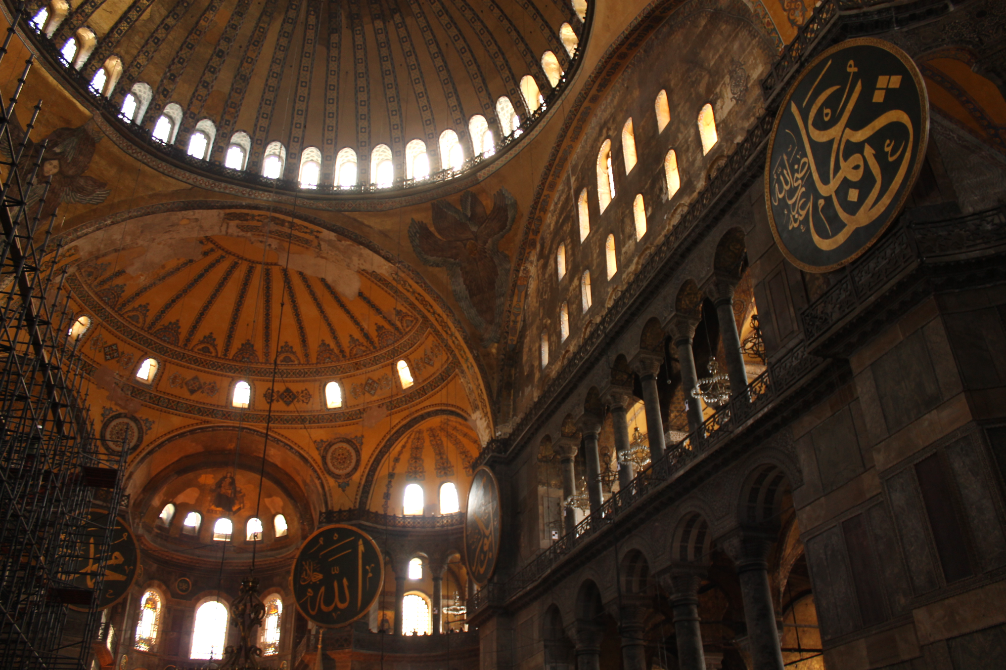

Slide 16
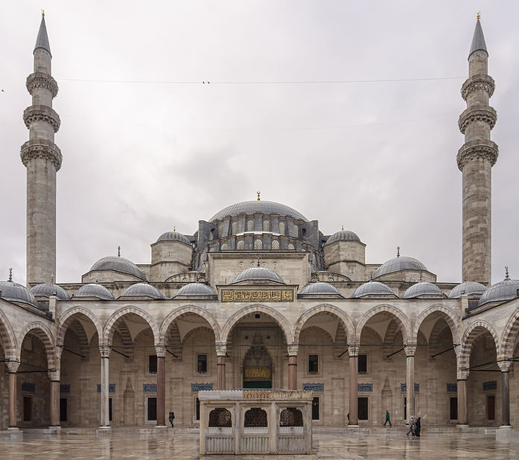
Süleymaniye Mosque

Slide 17
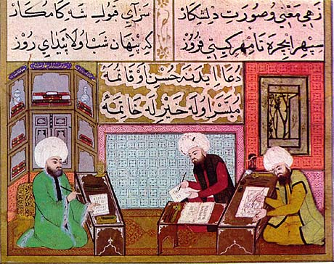
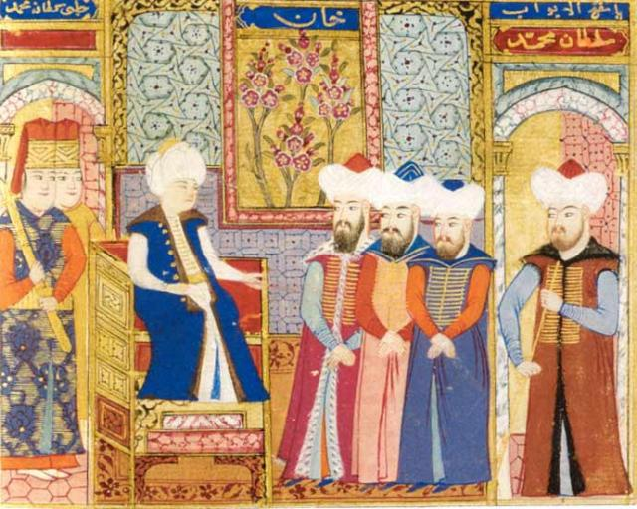
Ottoman Miniatures

Slide 18
What type of insight do these documents provide about Ottoman society, success and relationship to non-Muslim subjects?
Document 4
Document 5

Slide 19
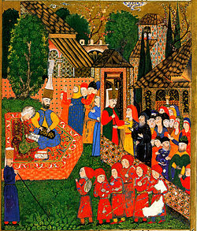
Ottoman Society…policy & trends
Sultan increasingly wealthy and removed from subjects
Warrior Aristocracy increasingly removed from inner circle of sultan
Bureaucracy increasingly gains power and influence
scholars
Grand Vizier
Janissaries (Devşirme) yeni cheri or "new troops”
People of the Book- tolerated, but restricted
Jizya
Islamicisation of Bosnia
Millet communities
“Ruled from the harem”

Slide 20
Battle of Lepanto, 1571

Slide 21
Safavid Empire
The Turkish speakers of Azerbaijan are mainly descended from the earlier Iranian speakers, several pockets of whom still exist in the region. A massive migration of Oghuz Turks in the 11th and 12th centuries not only Turkified Azerbaijan but also Anatolia. Azeri Turks were the founders of Safavid dynasty.
From the evidence available at the present time, it is certain that the Safavid family was of indigenous Iranian stock, and not of Turkish ancestry as it is sometimes claimed. It is probable that the family originated in Persian Kurdistan, and later moved to Azerbaijan, where they adopted the Azari form of Turkish spoken there, and eventually settled in the small town of Ardabil sometimes during the eleventh century.
1501-1722

Slide 22
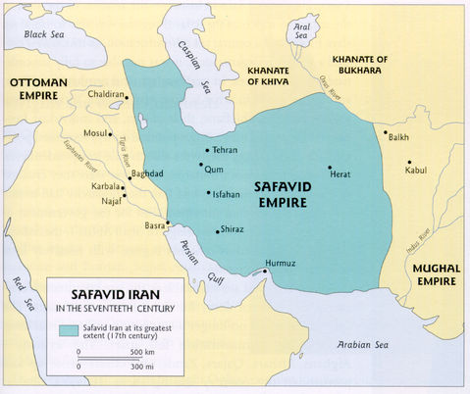
Safavid Religion & Politics
Document 6
Founded by Ismail – first to claim shah title
Sufi religious order (Sheikh Safi al-Din)
Twelver Shiism legitimized rule
Rallied qizilbash
Conflict with Ottomans
Shah Abbas the Great
R. 1588 -1629
Restored Empire
Est. Ishfahan
Patron of the arts
period of cultural florescence

Slide 23
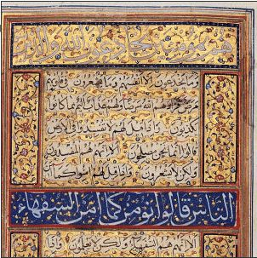
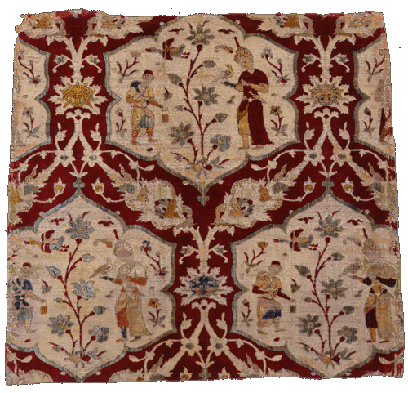
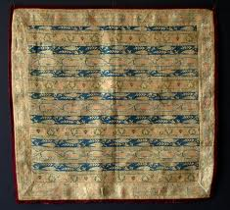
Manuscripts, Textiles (silk)

Slide 24
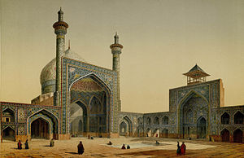
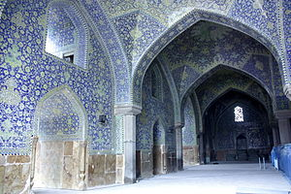
Painting by the French architect, Pascal Coste, visiting Persia in 1841.
Imam Mosque Isfahan

Slide 25
Mughal Empire
1526–1857

Slide 26
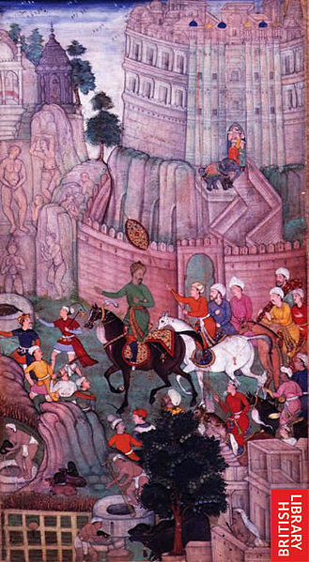
Mughal Religion & Politics
Document 7
Muslim Rule/Hindu Majority
Babur
Brings forces out of Hindu Kush region into South Asia
Defeated last of Delhi Sultans
Akbar the Great
Toleration & Syncretism
Divine Faith
Empire tripled in size and wealth

Slide 27
Cities & Trade
What was the role of the Muslim empires in the new age of Global Trade?
How would you characterize their interactions with the West?

Slide 28
Land-based agricultural surplus economies as foundation for…
Urban Centers of industry, craftwork and exchange
Istanbul
Delhi Triangle:
Shahjahanabad
Ishfahan

Slide 29
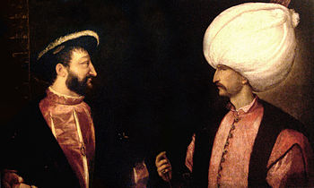
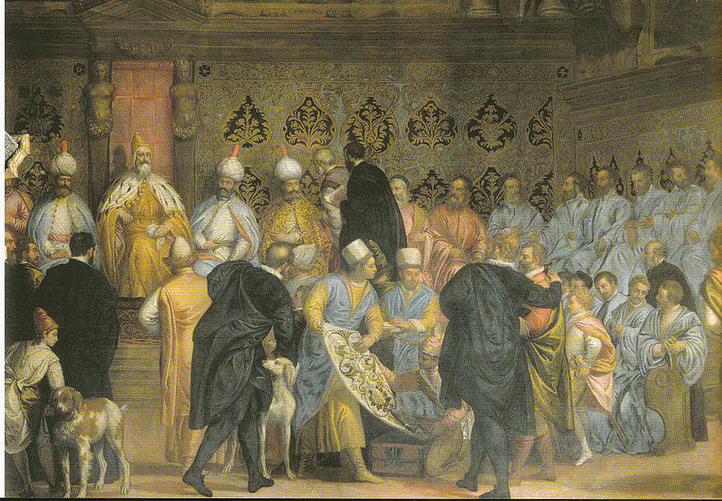
Document 8
Francis I (left) and Suleiman I the Magnificent (right) initiated the Franco-Ottoman alliance. Both were separately painted by Titian circa 1530.
Fresco in the Doge's Palace in Venice depicting Doge Mariano Grimani receiving the Persian Ambassadors, 1599
How did the relationship of Muslim Empires with the West compare to the relationship forged by East Asia?

Slide 30
Decline of the Muslim World
Patterns & Trends

Slide 31
STAGNATION
OTTOMAN | SAFAVID | MUGHAL
1922 | 1722 | 1857
Internal multiregional, multiethnic conflict
Maintenance of traditional economies/
systems/
technologies
European intervention/
Resistance to local control

Slide 32
Ibn Kaldhun
Lifecycle of the Muslim Empires…
Consider our original question …
How did the reasons for both the rise and the eventual collapse of the Mongol Empires direct in many ways the historical development of the Middle East and India in the Age of Gunpowder Empires?

