Slide 1
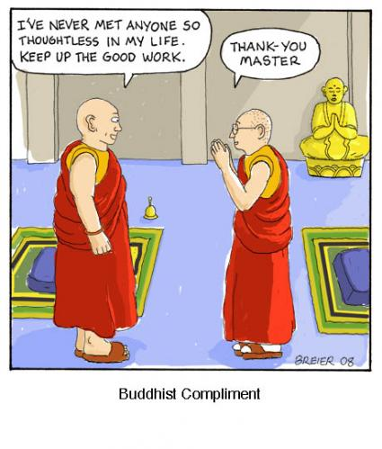

Slide 2
Ancient Greek
Philosophy
How did the Greek philosophers view humanity, and thus
what role did they play in shaping Classical Age Greece?

Slide 3
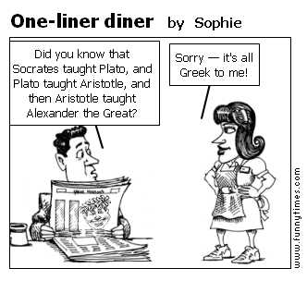
Socrates, Plato and Aristotle…

Slide 4
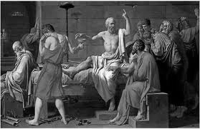
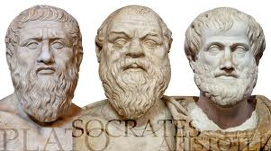
468BCE -322BCE

Slide 5
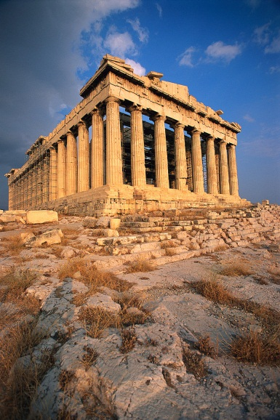
Historical Setting
Motivation behind the
Philosophical spirit…
Aftermath of the Persian War
Diffusion of people and ideas moved in and out of Athens
During battle, and into the aftermath of the Peloponnesian War
Long-held views of the natural world were called into question, focus shifted to the here – and – now – SECULARIZATION!

Slide 6
Small Group Discussion Forum
Table Groups of 3…
Each group has a document packet and guiding questions
Each student will take a turn facilitating the discussion for one question. Remember look to the document for evidence – not explicit answers!

Slide 7
What was their views regarding the proper organization of Government?
Disorder
Philosopher King
Golden Mean

Slide 8
The Irony…
Socrates was put to death by democratic government
Plato clearly rejected the notion of democracy, and
Aristotle doubted the efficiency of it
YET,
Their philosophical ruminations have, more than any other specific historical development, encouraged the creation of the Western Ideal and democratic principles.
Why? And How do we know…

Slide 9
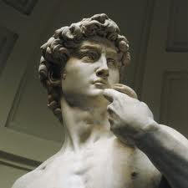
The David, Michelangelo

Slide 10
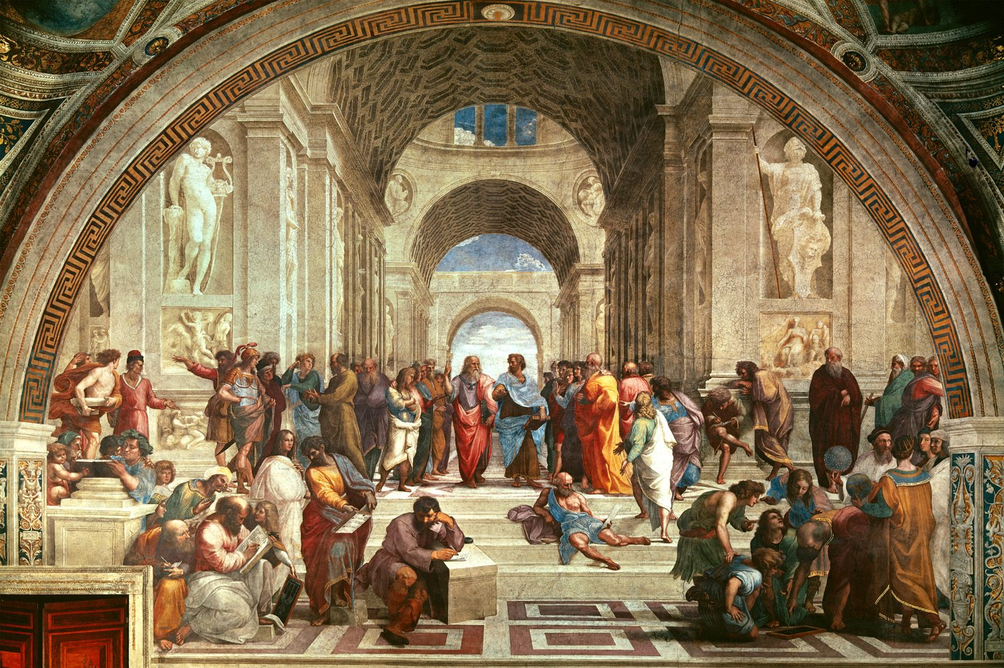
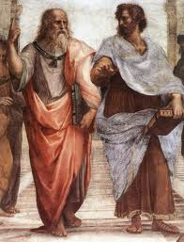
School of Athens, Raphael

Slide 11
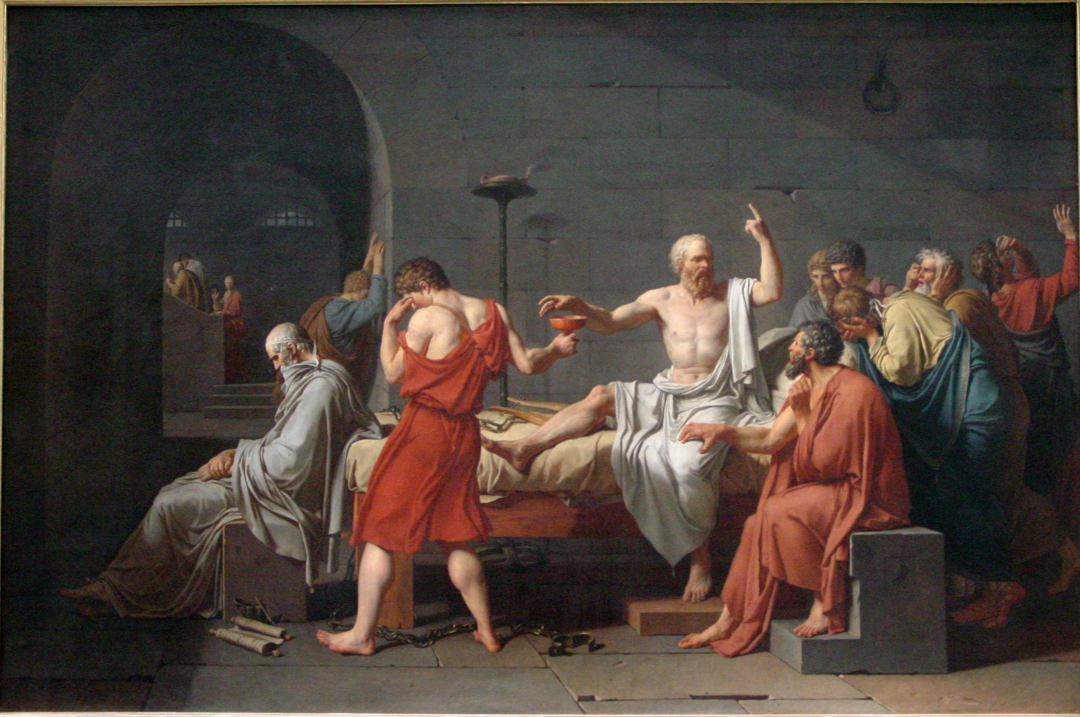
Jean Louis David, The Death of Socrates

Slide 12
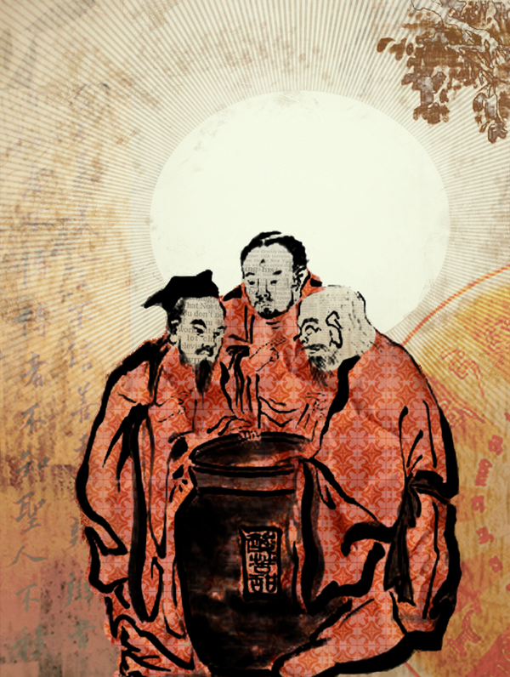
How is Asian thought and its impact different?
Vinegar Tasters
Follow the rules…
Caste
5 relationships
Legalist Qin Laws
8 Fold Path

Slide 13
Western Ideals
Spirit of Inquiry
Power of Man- Innovation!
Individualism- Self-determination!
Reason and Logic- Scientific Understanding!

Slide 14
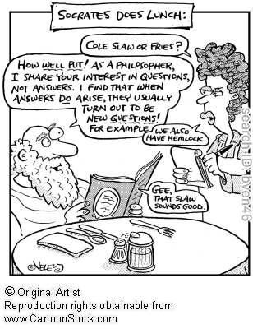
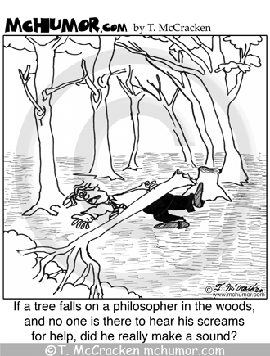

Slide 15
“Wit is educated insolence.”
Aristotle
Plato: For the greater good. Aristotle: To actualize its potential.
Why did the chicken cross the road?

Slide 16
