Slide 1
The Protestant Reformation
1517-1648

Slide 2
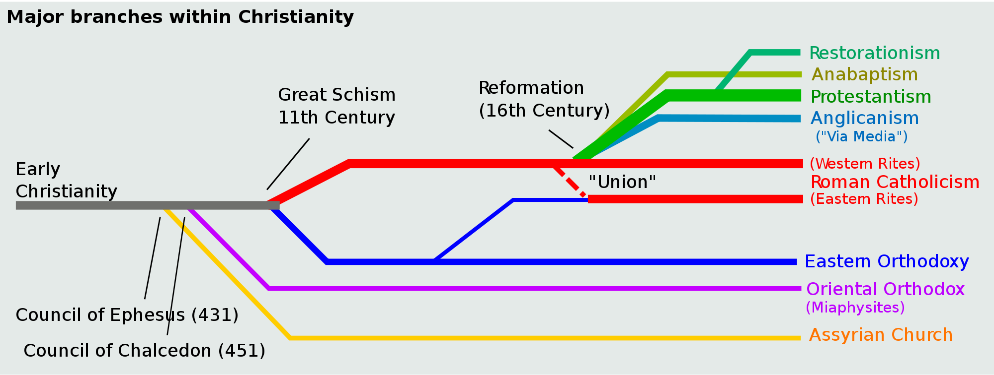

Slide 3
Why did the split of Western Christendom happen when it did?
Long Term Causes…
Catalyst?
More Immediate Causes …

Slide 4
The reader who wishes to understand the religious revolution, and consequent emergence of Protestantism, to which we shall now turn, must bear in mind the extraordinarily intricate interplay of the factors [taking place throughout Europe]: the decline of the Church, the growth of secular and humanistic feeling, …the rise of monarchs who wished to control everything in their kingdoms, including the Church, the resistance of feudal elements to these same monarchs, the lassitude of the Popes…. the atomistic division of Germany, the Turkish peril, the zeal of Spain, the preeminence of Charles V, and the fears felt in the rest of Europe, especially France, of absorption of suffocation by the amazing empire of the Habsburgs.
Palmer and Colton

Slide 5
Martin Luther
Catalyst to Reformation

Slide 6
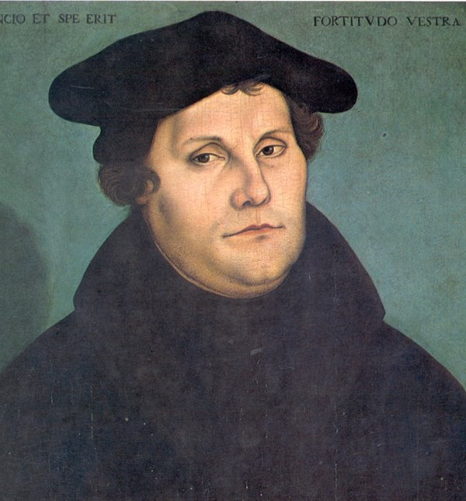
Luther’s Reformation
Luther initially saw himself as a great reformer of the Catholic church …
95 Theses
21. Therefore those preachers of indulgences are in error, who say that by the pope's indulgences a man is freed from every penalty, and saved;
36. Every truly repentant Christian has a right to full remission of penalty and guilt, even without letters of pardon.

Slide 7
The Empire: The Holy Roman Empire is neither Holy, nor Roman, nor an Empire. Voltaire

Slide 8
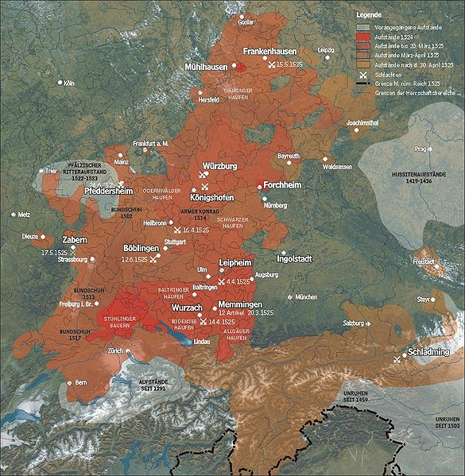
Peasant Revolts
12 Articles of the Peasants of Swabia
Economic, political & religious in nature

Slide 9
Peasant rebellions

Slide 10
it is our humble petition and desire, as also our will and resolution, that in the future we should have power and authority so that each community should choose and appoint a pastor, and that we should have the right to depose him should he conduct himself improperly. The pastor thus chosen should teach us the Gospel pure and simple, without any addition, doctrine or ordinance of man.
We are thus ready to yield obedience according to God's law to our elected and regular authorities in all proper things becoming to a Christian. We, therefore, take it for granted that you will release us from serfdom as true Christians, unless it should be shown us from the Gospel that we are serfs.
A Social Revolution?

Slide 11
Luther’s Response
"Against the Murderous and Thieving Hordes of Peasants" 1525
In my preceding pamphlet [regarding the "Twelve Articles"] I had no occasion to condemn the peasants, because they promised to yield to law and better instruction, as Christ also demands (Matt. vii. 1). But before I can turn around, they go out and appeal to force, in spite of their promises, and rob and pillage and act like mad dogs. From this it is quite apparent what they had in their false minds, and that what they put forth under the name of the gospel in the "Twelve Articles" was all vain pretense. In short, they practice mere devil's work, and it is the arch-devil himself who reigns at Mühlhausen, indulging in nothing but robbery, murder, and bloodshed;

Slide 12
In Response to Luther…
German “Lutheran” Princes
Christian Humanists
Religious Conflict
Reformers disagree: doctrine, role of government, feudal obligations, gender
Monarchs align…
Council of Trent: Inquisition, Jesuits, Index of Forbidden Books
Wars/Conflicts: Germany, France, Netherlands, England
Zwingli & Calvin
Henry VIII
Defender of the Faith
Radical Reformers: Anabaptists
Counter or Catholic Reformation

Slide 13
Political Consequences…
What attitude did the newly reformed Christian Churches take regarding the question of government and religion?
How did the Roman Church maintain its influence & ‘control’ of the regions that maintained their Roman catholic connection?
What regions continued to undergo changes, both political and religious after Luther?

Slide 14
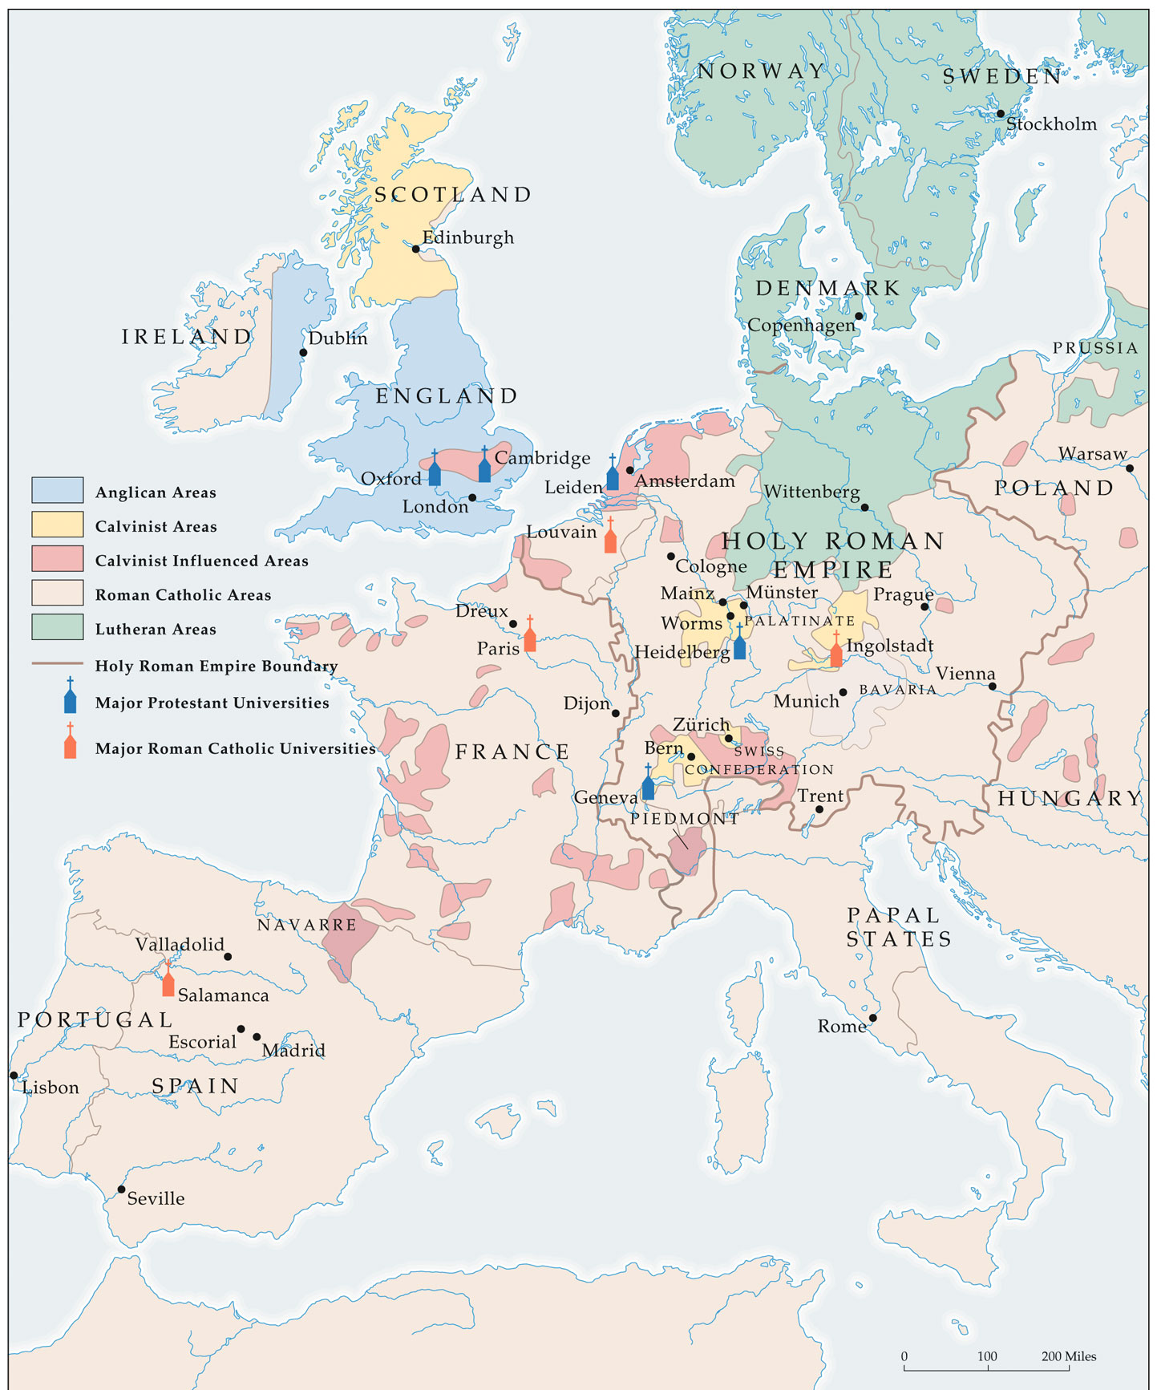
Lutheran: Northern Germany, Scandinavia
By 1555…
Western Christendom was shattered
English/
Anglican Church
Calvinism?

Slide 15
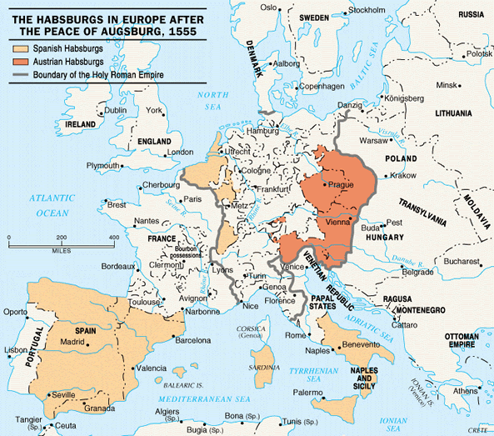
Why 1648?
Significance of the 30 Year’s War…
Resolved by the treaty of Westphalia in 1648
at the beginning … it was the Catholics vs. the protestants.
In the end … it was Hapsburg power that was threatened .
The Empire becomes 300+ autonomous states…
Hapsburgs turn east to Ottoman territory
Rise of Prussia
Rise of Bourbons
Decline of Spain

Slide 16
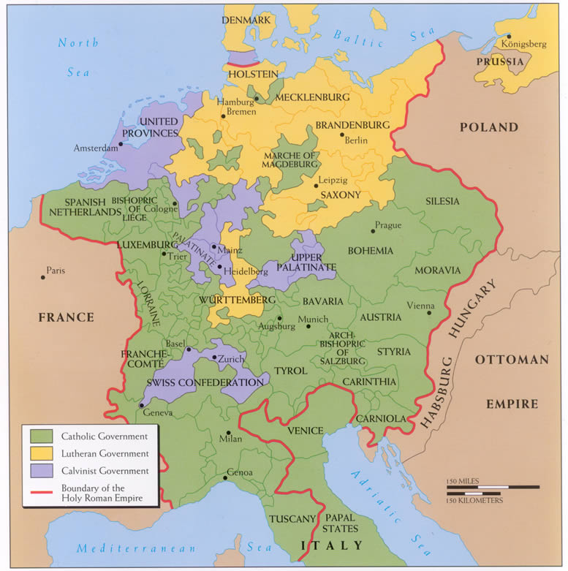
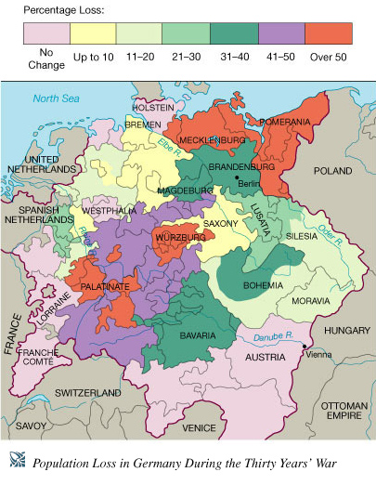
Peace of Westphalia

Slide 17
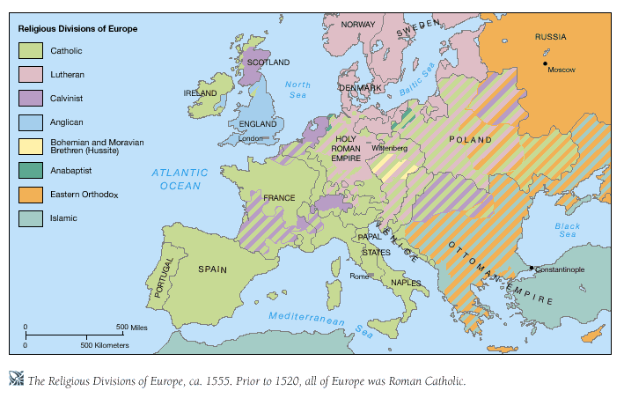

Slide 18
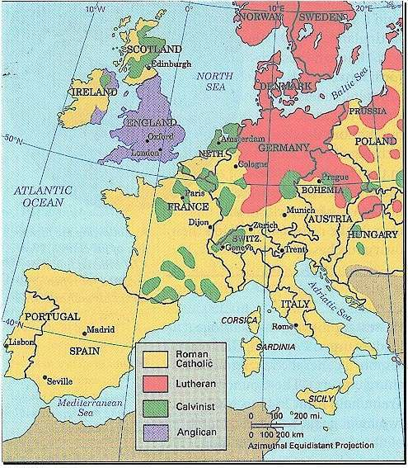
While Western Europe remains predominantly Christian, BY 1648 religion as a separate issue gives way to politics and the Balance of Power throughout Europe

Slide 19
Reformation as a turning Point
The Reformation contributed to the shaping of modernity

Slide 20
By dividing Christendom into Catholic and Protestant, the Reformation destroyed the religious unity of Europe, the distinguishing feature of the Middle Ages, and weakened the Church, the chief institution of medieval society.

Slide 21
By strengthening monarchs at the expense of church bodies, the Reformation furthered the growth of the modern secular and centralized state.

Slide 22
While absolute monarchy was the immediate beneficiary of the Reformation, indirectly Protestantism contributed to the growth of political liberty – another feature of the modern West. Protestantism accomplished this by providing religious justification for revolution against tyrannical rule.

Slide 23
The Reformation advanced the idea of equality. For instance, M. Luther held that there was no spiritual distinction between the laity and clergy. There was a spiritual equality of all believers: all were equally Christian; all were equally priests (the priesthood of believers)

Slide 24
The Reformation contributed to the creation of an individualistic ethic. Protestants insisted on the individual’s rights and responsibilities to interpret Scripture according to the dictates of his or her conscience. Piety, therefore, was not determined by the Church, but by the autonomous individual, whose conscience, illuminated by God, was the source of judgment and authority.

Slide 25
Protestant Work Ethic
The Reformation’s stress on individual conscience may have contributed to the development of the capitalist spirit, which underlies modern economic life.

Slide 26
Max Weber, Weber Thesis
The Protestant Ethic and the Spirit of Capitalism (1905).
Calvinist Influence
Protestant Asceticism
Aristocratic nature – (Predestination)
Investment & Capital
Whoever works hard in the pursuit of gain fulfills a moral obligation
Ben Franklin’s writings… time is money

Slide 27
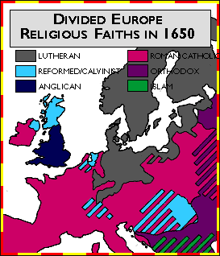
Lutheran Influences…
North German States
Scandinavia - Sweden
Calvinist Influences…
Scotland – Scotch-Irish
Geneva
Bohemia
Netherlands
England…
Via Media

