Slide 1
Understanding 1450…
Consider all parts of the human story
A true World History approach

Slide 3
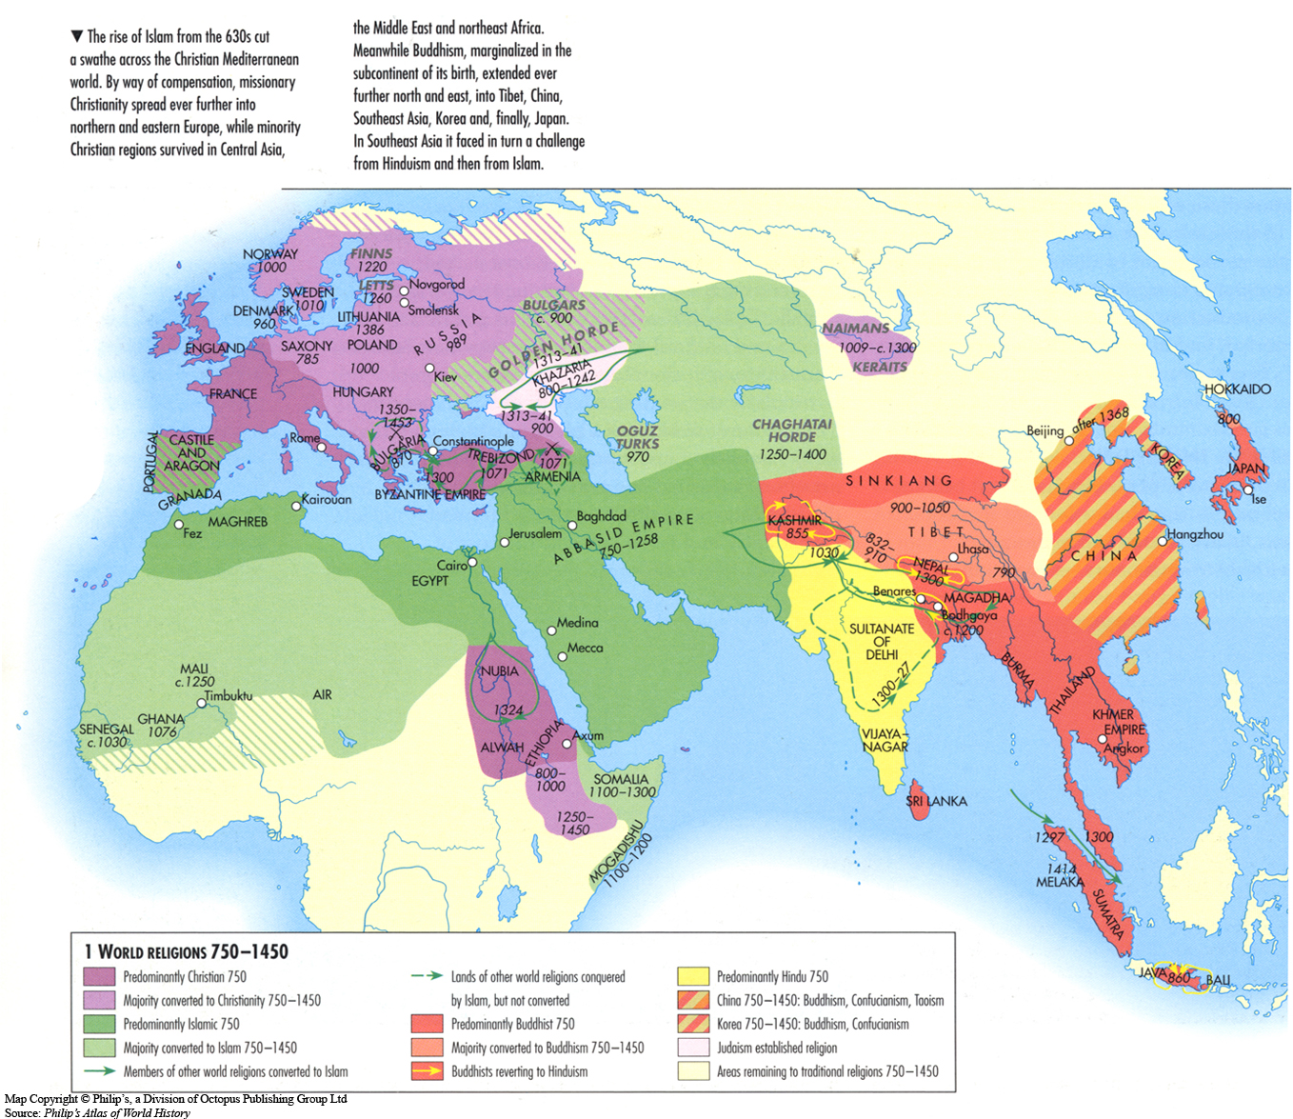

Slide 4
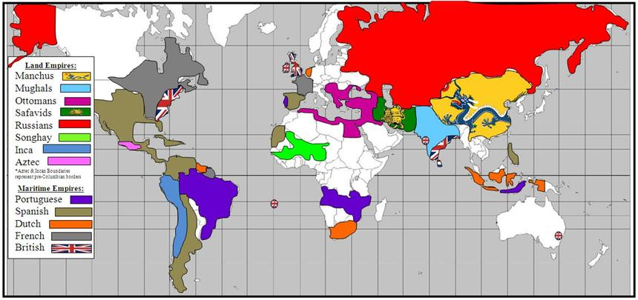

Slide 5
In 1450? A regional view
Western Europe
Central/West Asia
Sub Saharan Africa
East Asia

Slide 6
Big Understanding: Changes a global view
Aftermath of Mongol Conquests
Legacy of Abbasid Dynasty
Awakening of Western Europe
Ottoman Expansion
Death of Constantinople
Reassertion of Chinese Rule

Slide 7
What was at the heart of the choices made by Europeans and the Chinese?

Slide 8
Emergent, or re-emerging Philosophies
Neo Confucianism and Renaissance Humanism

Slide 9
Comparative examination
Neo Confucianism
Renaissance Humanism

Slide 10
Similarities,
Specific examples
Appreciation for Greco- Roman World / Confucian Teachings
Literary Analysis
Men of Virtu / Castiglione’s The Courtier
Golden Age of the Arts
Reciprocal nature of European life changes relegating women to extension of man/ Foot binding and further subjugation of Women during Song period
consider
Relationship to Past
Academia
Expectations of Social Behaviors
Artistic Creativity
Gender Expectations

Slide 11
Differences,
Specific examples
consider
Relationship to outside world
Political Impetus
Future Impact
Spirit of Inquiry drives voyages of exploration /Zheng He’s voyages halted
Fragmentation of Western Europe drove competition/ Centralization of Power under Song Bureaucracy – scholar gentry
“Rise of the West”? And innovation / Chinese conservatism and stagnation

Slide 12
Bringing it all together…
Consider Historical Context discussed in the beginning of lesson (1450)
Develop points of comparison that speak to the ‘big idea’, or thesis (why are they similar, why are they different)
Why is this significant for world historical development?

